Slide 1


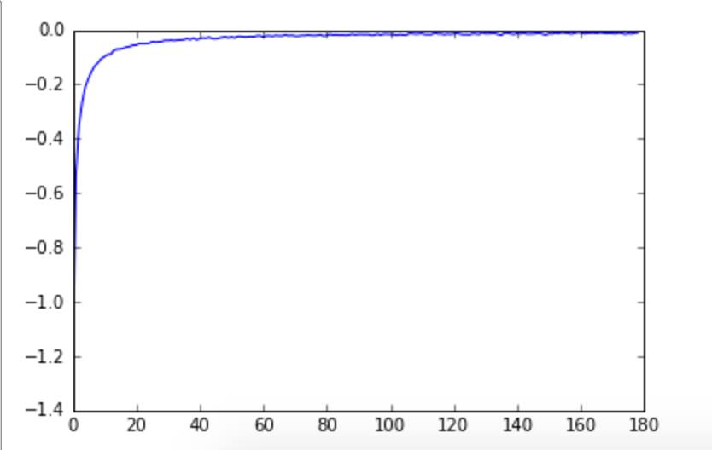
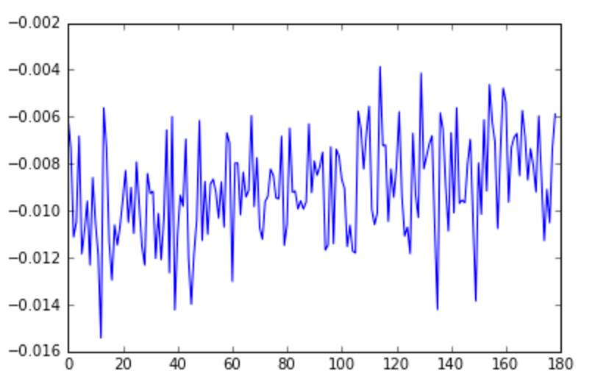
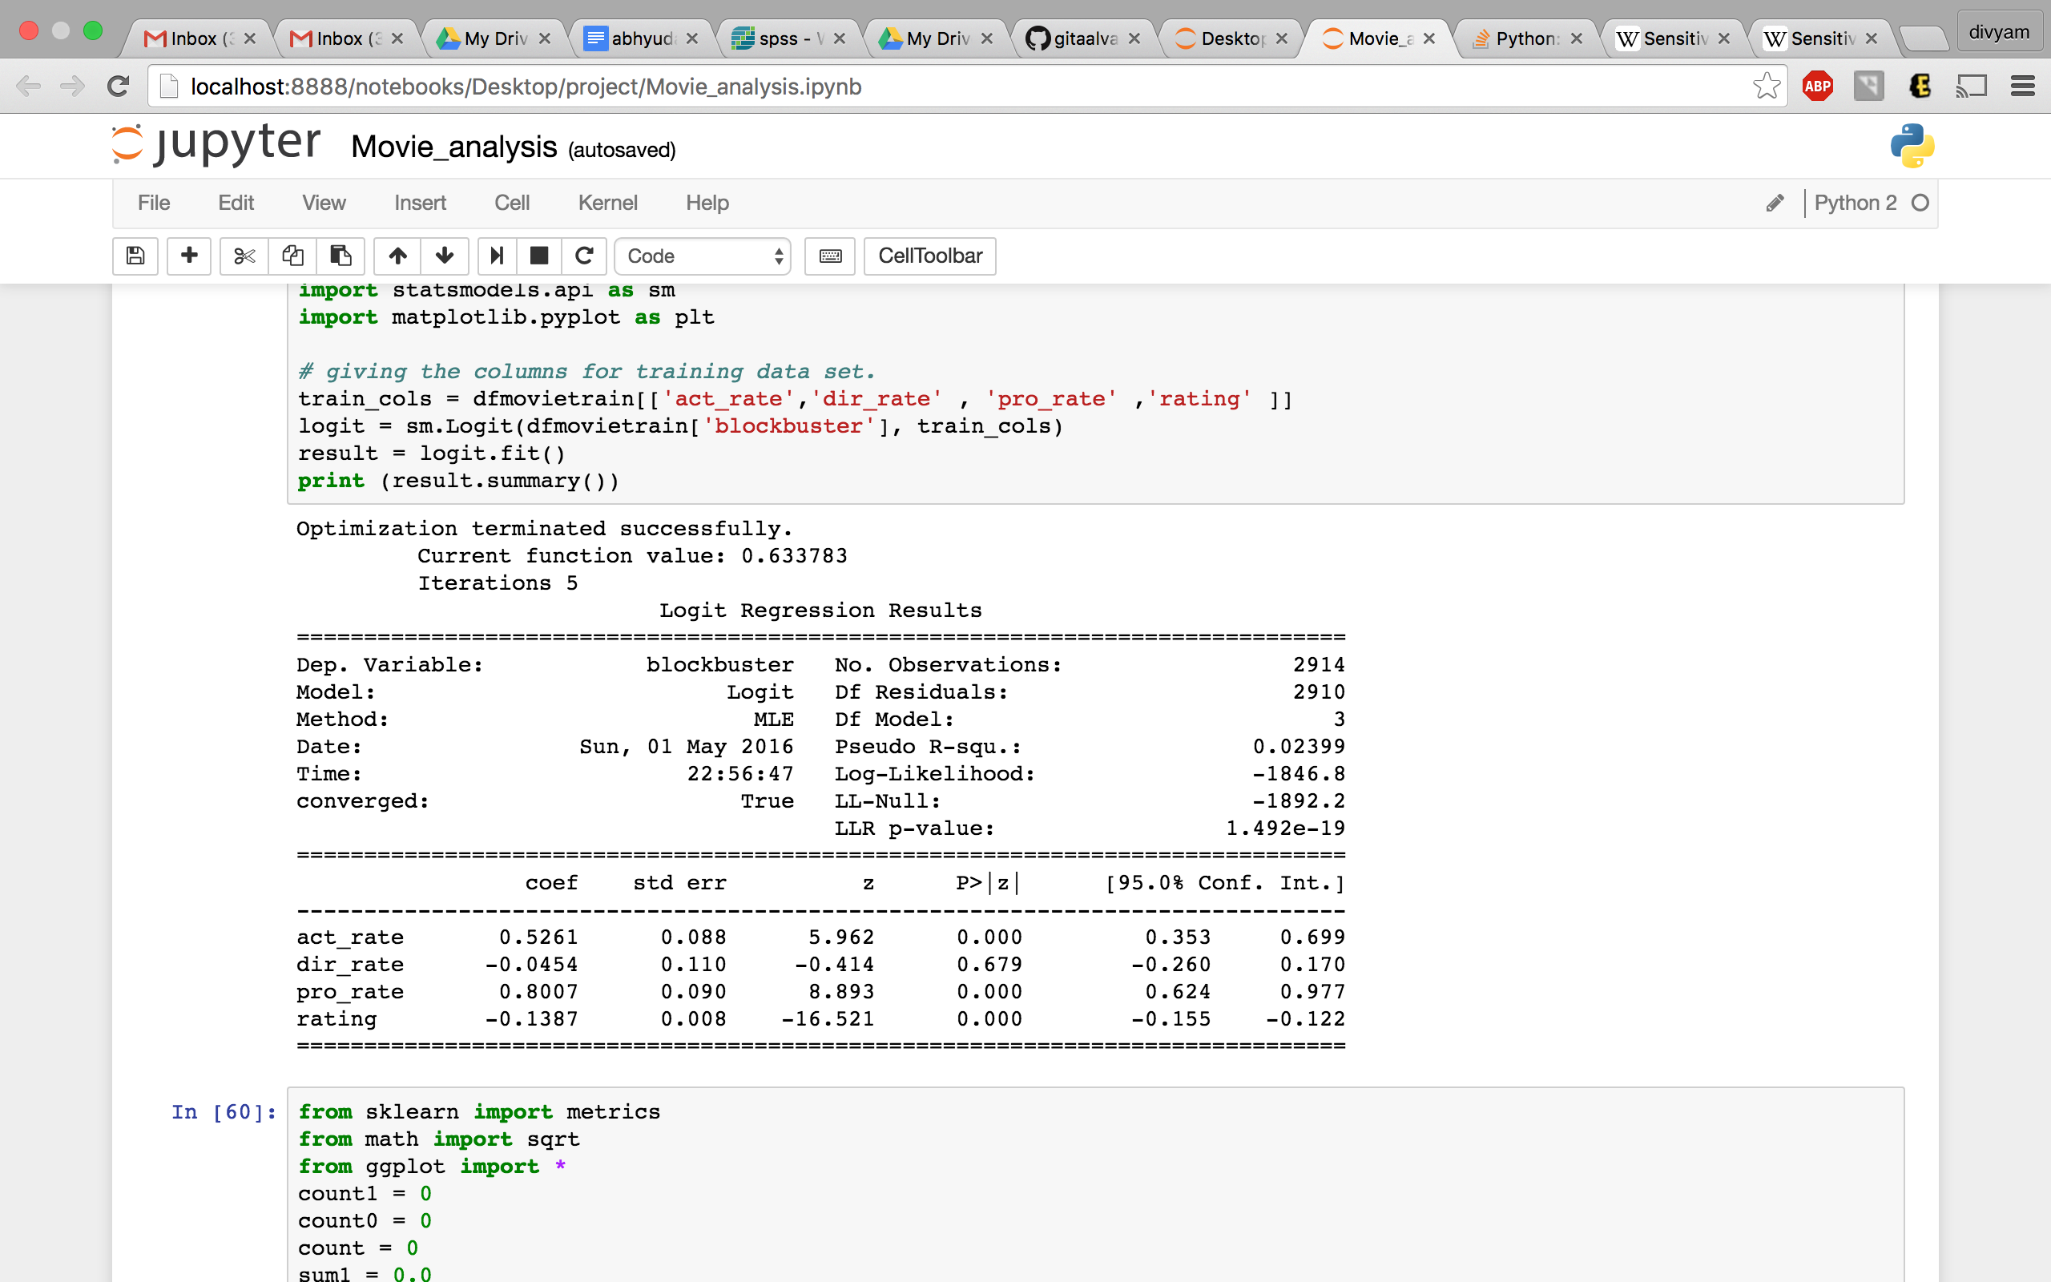
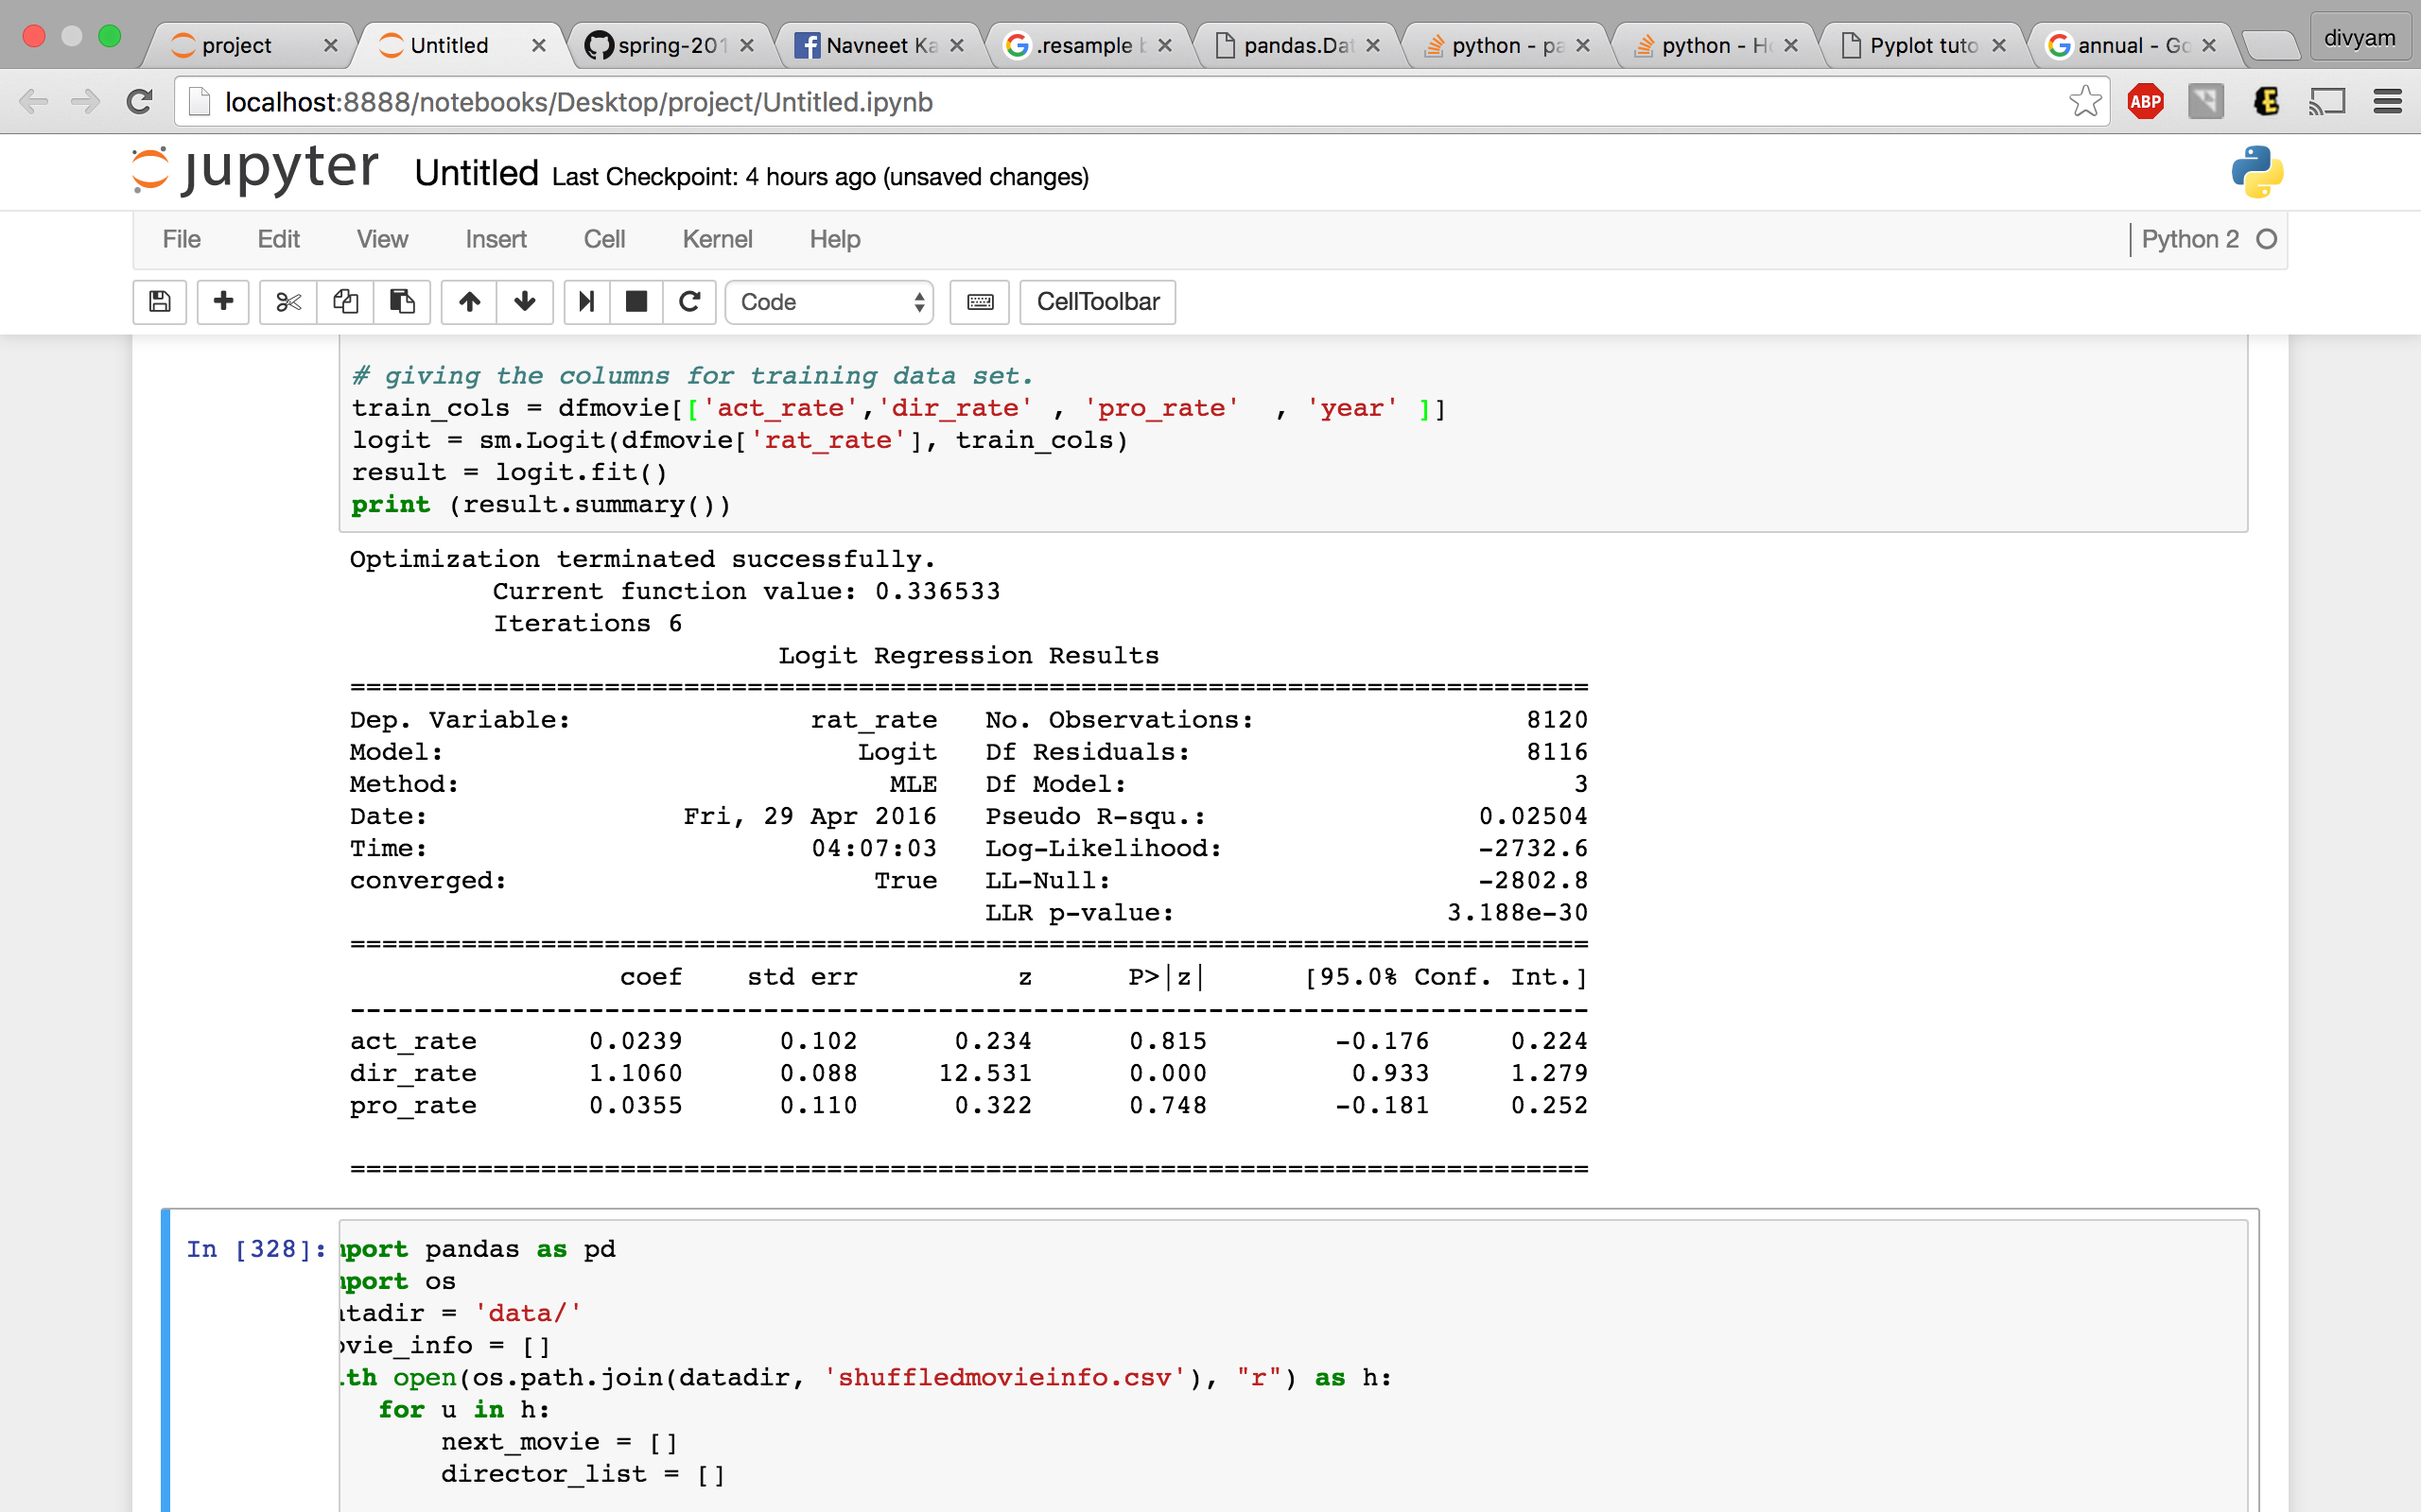
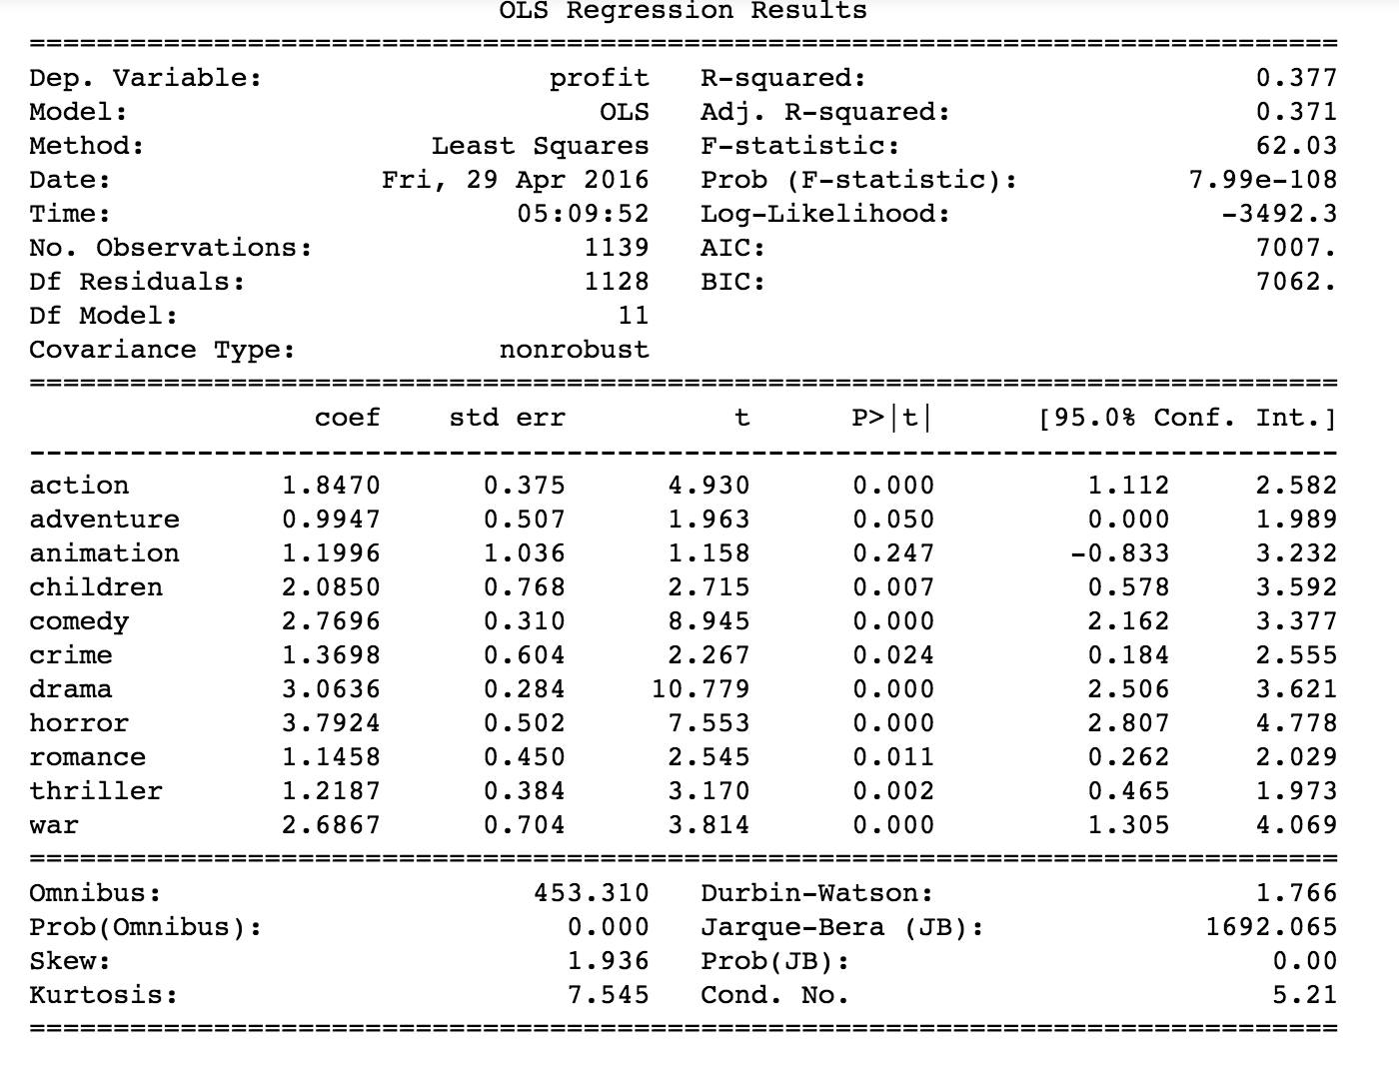
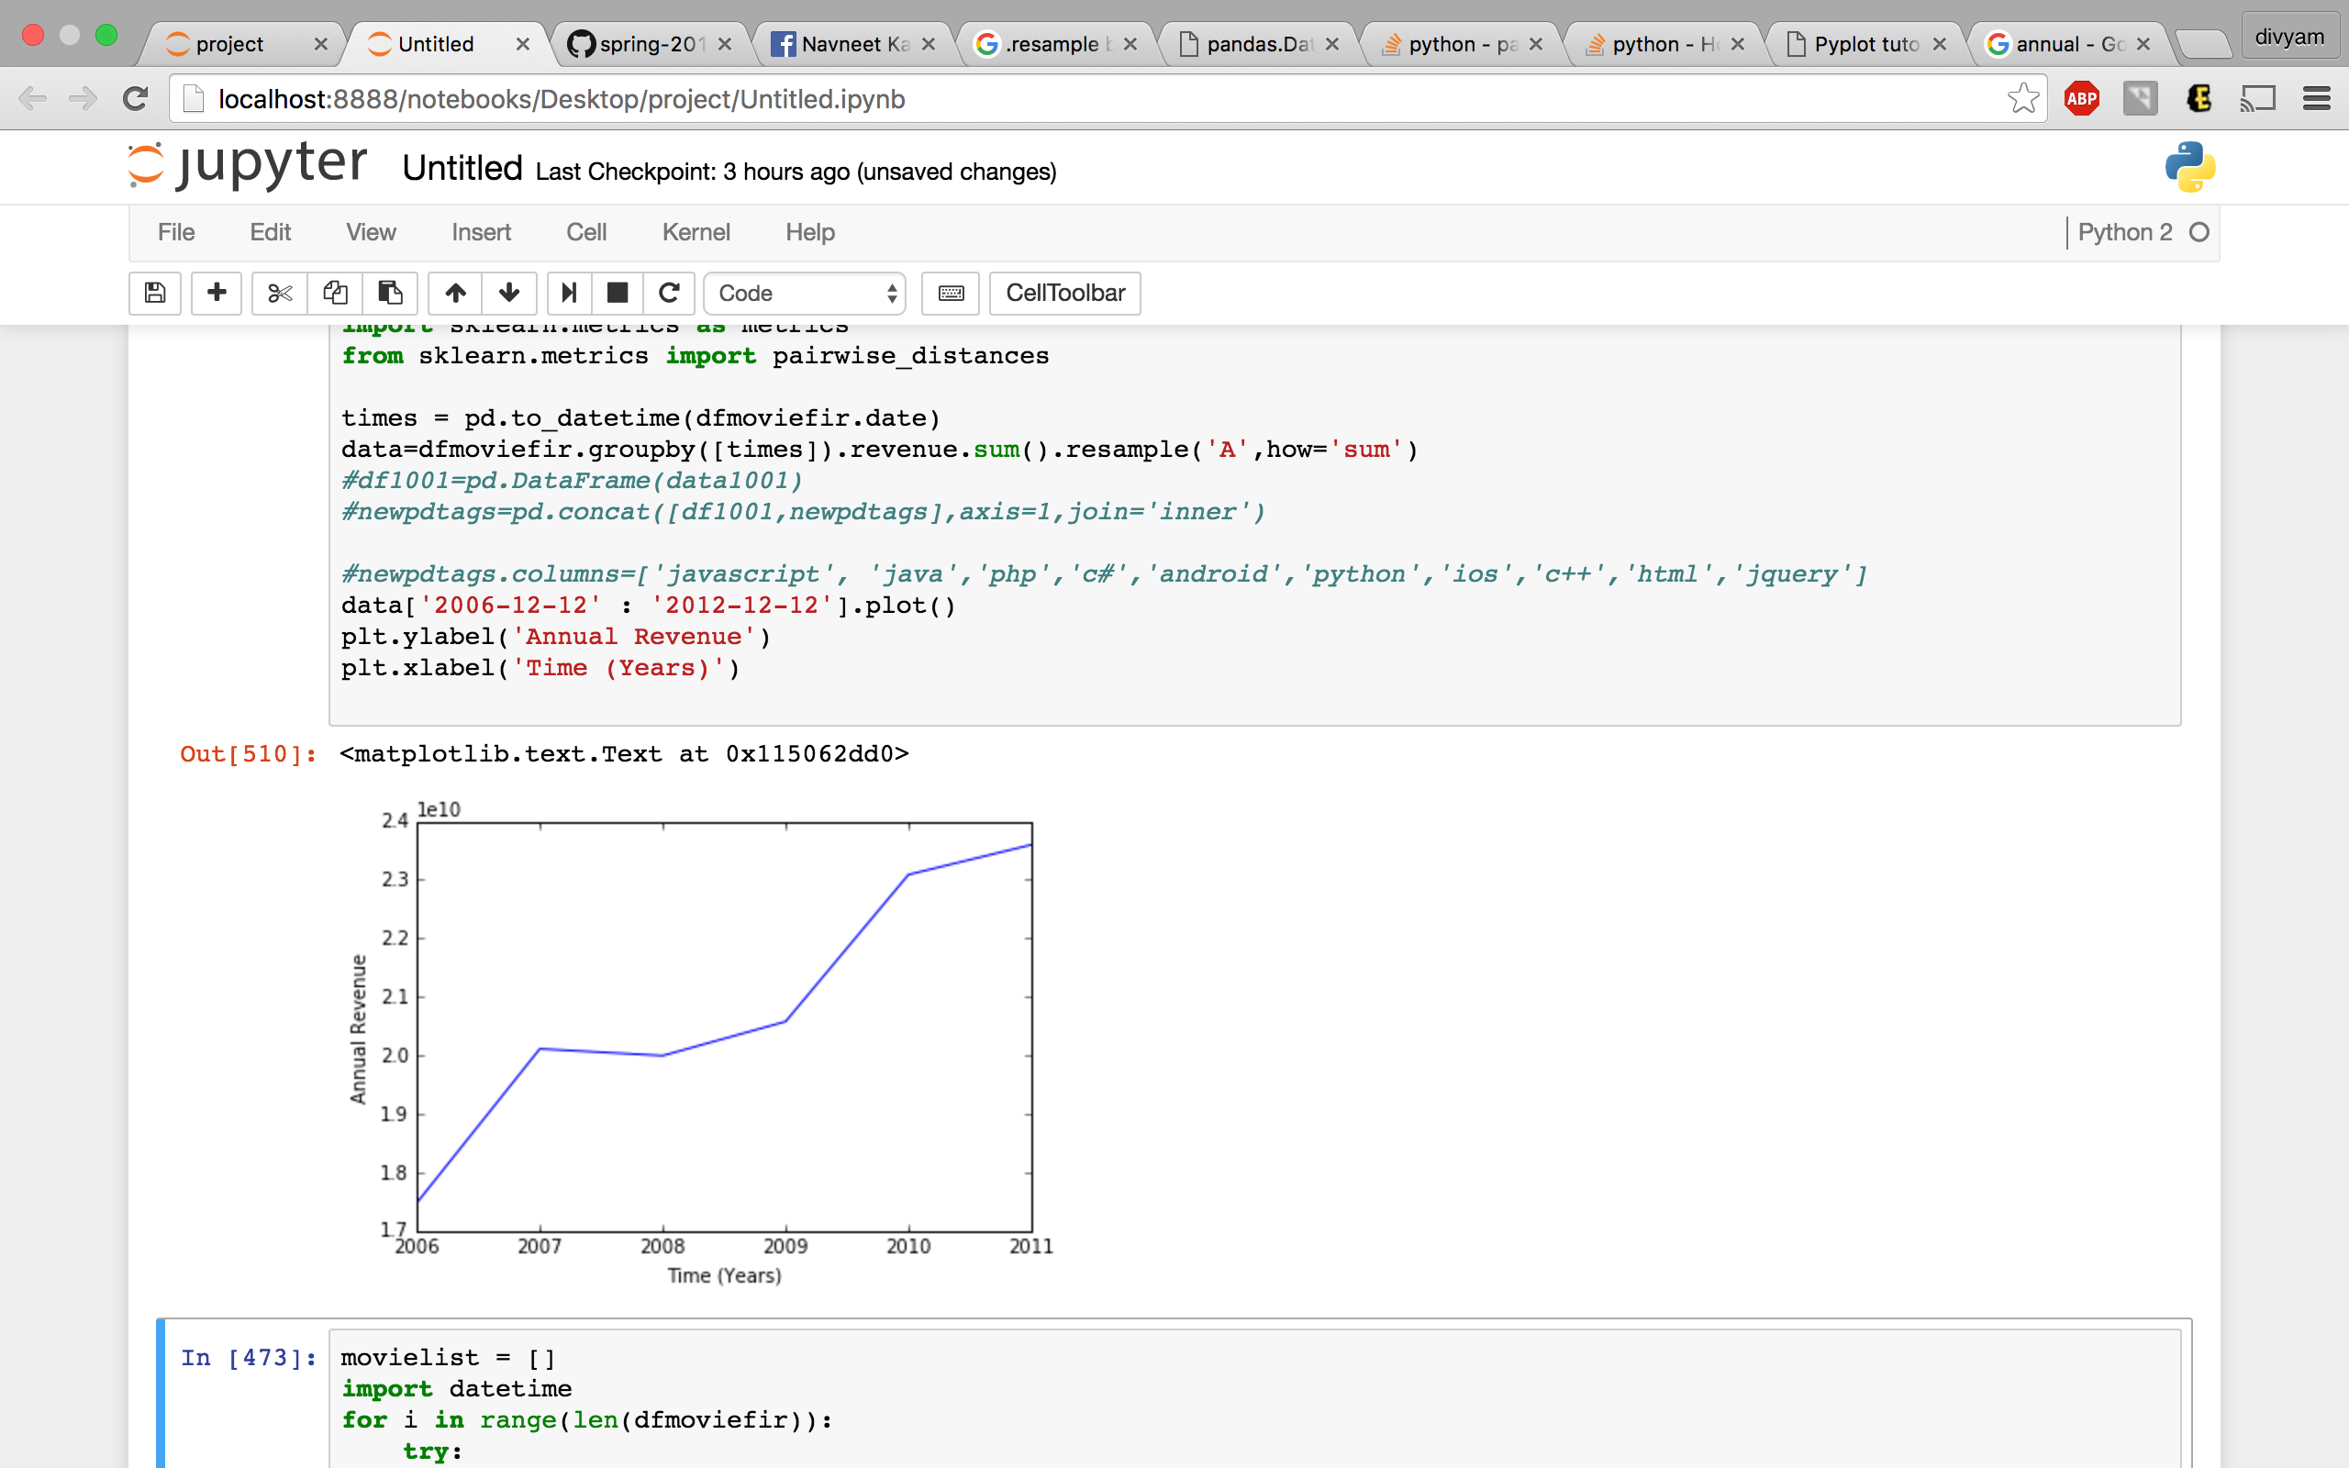
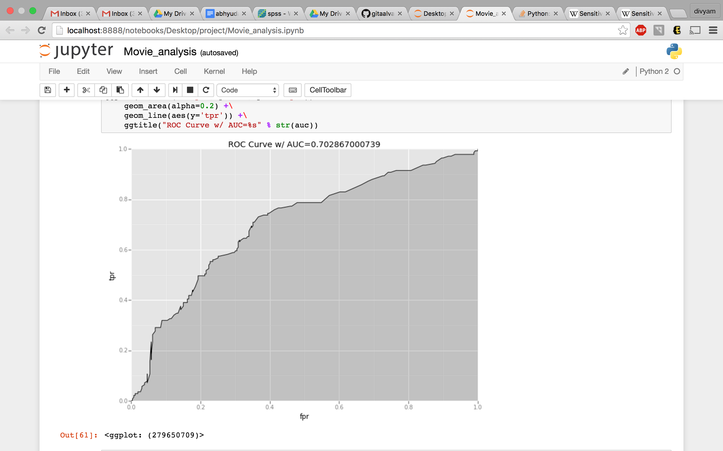
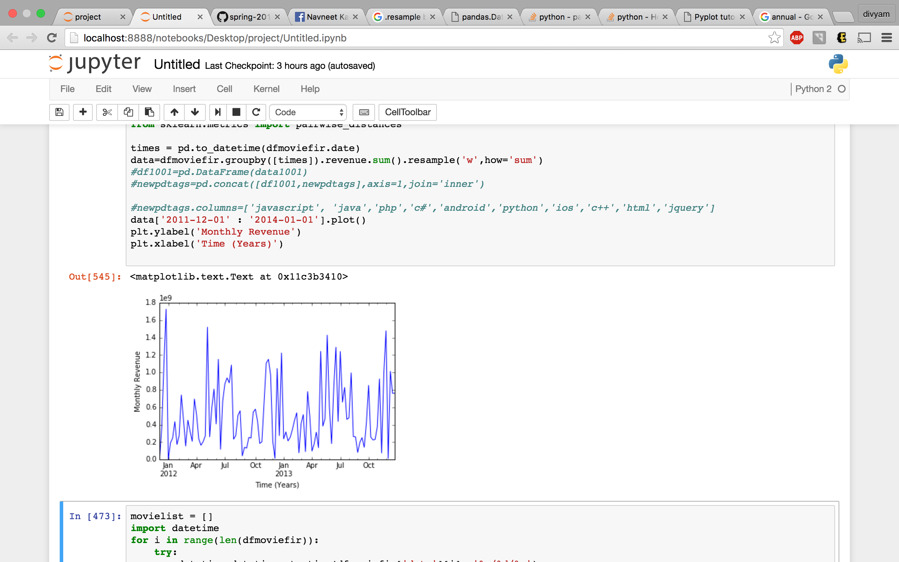
Movie Data Analysis
Divyam Hansaria & Abhyudaya Alva Boston University
GRS Computer Science Department
Introduction
The film industry is volatile and unpredictable. Many movies barely break even in the box office and on the other hand some movies end up earning over 10 times their budget.
Is there any way to find out what are the important factors which make a movie economically and rating wise successful. Does high rating imply higher earning ?
Can we predict what movies will be liked by a particular user based on his reviews of other movies. Does specific genres get more preference over others ? Can we predict weather a movie is going to be successful in box office or not and
Results
From the movie lens 20 million dataset, we built a recommendation system using stochastic gradient descent. The RMSE error achieved using this algorithm was 0.865 with learning rate 0.02 and lambda 0.1
For every movie for the last 16 years we checked if their actors, director and production house belonged in our top lists and gave the value 1 or 0 accordingly. We performed a logistic regression for calculating blockbuster which we defined as 1 if the movie’s revenue was over 4 times the budget.
We performed logistic regression to analyze significant factors that predict ‘rating rate’ which we defined as 1 if the IMDB rating was above 7.5 else 0.
Conclusions
From the regression models we could see that the most important factors for a movie to be economically successful are the actors and the production house. Where as for the movie to be successful rating wise the most significant factor is the director.
We observed that rating or first week collection of the movie are not important factors for a movie to do good economically.
From the year graph we can clearly see a dip in the annual revenue during the years 2007-2008.
From the weekly graph we can observe that the maximum revenue is generated during December and the Summer (May-Aug).
For the prediction of user’s rating for the movies we found that stochastic gradient descent gives the best results and is scalable.
We did 2 sample test to study gender preference for movie genre and found that men rate crime and horror movies slightly higher then women (diff : 0.03), overall there is no gender preference for movies.
From the linear regression we observed that movies belonging to comedy, drama, horror and war genre are more likely to do better economically
From the AUC we can see that our logistic model performs better then random predictor.
Figs: Error graphs representing the learning of the algorithm used to judge convergence .
Goals
Build a recommendation system: Predict user ratings for movies.
Find what are the factors that make a movie successful economically as well as rating wise.
Find weather a correlation exists between ratings and profits.
Find if there is any pattern in the revenues earned by the past movies.
Find if there is any demographic or gender preference for movies.
Plot of annual revenue total revenue from 2006 – 2011 to show the movie industry during the recession period.
The Data
We scraped IMDB website for the top 500 movies by business for every year from 2000 to 2016 and removed movies which were missing any financial data.
We scarped IMDB website to get Top 500 Actors, Top 500 Directors and Top Production houses of all Times.
We got 20 million users rating data set from movielens.com with 138,493 users and 27,278 movies .
We used TMBD API to scrape all the other information required about the movies from movielens.com as these contend movies prior to 2000.
Finally we merged and connected all the data using their IMDB ID .
We performed simple linear regression to predict profit from genre.
Area under the curve plot for the logistic regression.
Plot of weekly revenue for the years 2012 and 2013 to show the revenue in different months during the year.
References
www.imdb.com
www.tmdb.com
www.movielens.com
F. Maxwell Harper and Joseph A. Konstan. 2015. The MovieLens Datasets: History and Context. ACM Transactions on Interactive Intelligent Systems (TiiS) 5, 4, Article 19 (December 2015), 19 pages. DOI=<http://dx.doi.org/10.1145/2827872>

